Slide 1

Sign language and Deep Learning
Sign language
Project topic :
Sign language hand gesture image classification on the MNIST Sign language dataset and farther applications.
Team : Backpropagation
Group Members: Georgoulis Ilias, Mouratidis Efstathios
Instractor: Mr.Barmparis

Slide 2
Contents:
1)Concept
2)Dataset
3)Model summary
4)Data augmentation
4)Model evaluation
5)Transfer learning
Second part
6)cv2
7)The video
8)Image process
9)Predictions on the video images
10)On video predictions
11)Video
12)Conclusions

Slide 3
Project proposal:
Primary goal:
Our primary goal was to do an image classification on the MNIST Sign language dataset.
Farther applications:
We tried to implement the model on a video of sign language letters representations.

Slide 4
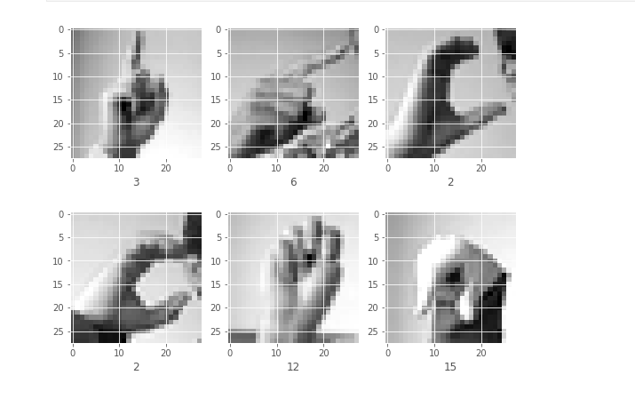
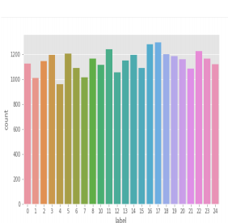
The Data Set
Consists of the training data (27,455 cases) and test data (7172 cases) gray scale Images of 28x28 dimensions.
Each image represents a letter of the american sign language.
The Sign Language MNIST data came from extending a small sized dataset with augmentation methods.

Slide 5
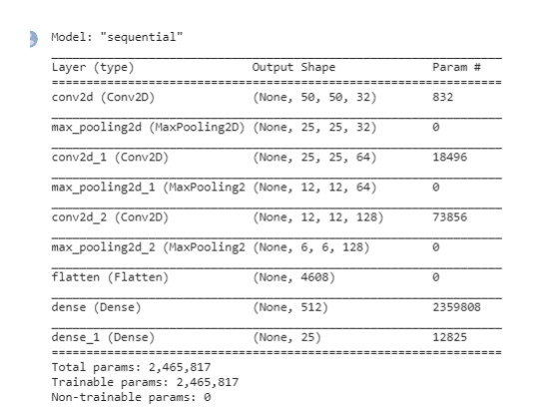
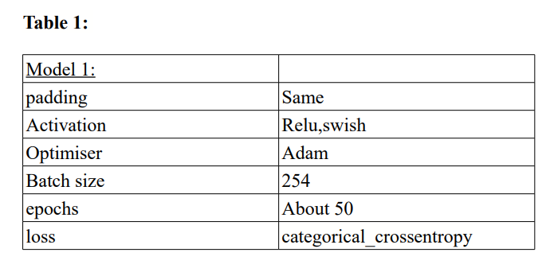
The model
Main Model summary:
The 3 convolutional layer model 32,(5,5) ,64,(3,3),128,(3,3) followed by (2,2) max pooling and one simple layer aften the flatten seemed to be the best structure.

Slide 6
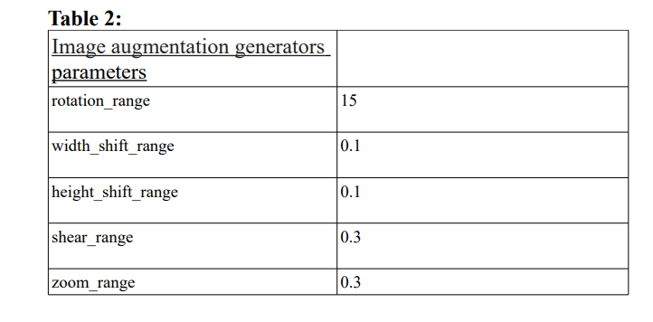
Data augmentation
We attempted to implement data augmentation during model optimization. Something that made a big difference in our models' behavior and stability.It also made the training time slower.
We found out that small values of the parameters (Table 2) were better for the new augmented data and did not significantly increased the train time.

Slide 7
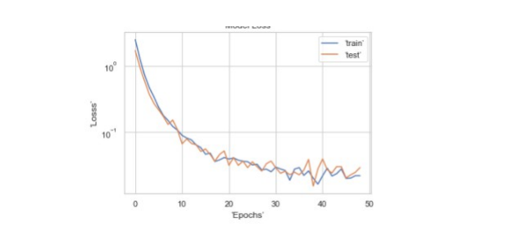
Model evaluation:
After the optimisation process our final model achieved 99% accuracy on the test set.
Its very high accuracy is most likely due to the simplicity of the train set as its images are a result of augmentation methods .

Slide 8
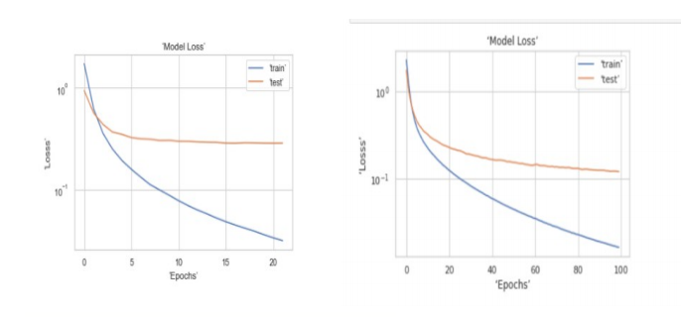
Transfer learning
As a way to evaluate it and check its ability on feature extraction we used our model as pre trained on a similar dataset. For that, we used the Sign Language Digits Dataset consisting of about 2000, 64x64 images of sign language numbers. Using the models convolutional layers, keeping its weights untrainable and only by adding a 10 dense layer, we achieved 95% accuracy on the new dataset.

Slide 9
Second Part
Models prediction on data from video file and live webcam capture using cv2.

Slide 10
cv2
The library used to manipulate the pictures and the video was the open cv contribute python.
It is a library that can manipulate pictures and videos and is used in general to solve computer vision problems.
Has in built movement and object detectors.

Slide 11
The video
The video used is 1 minute and 40 seconds long with 720 height and 1280 width images.
We randomly took pictures of the from the video but we used the pictures that came after the 600 frame because thats when the letters start.
We did the same for our live predictions.

Slide 12
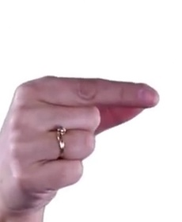
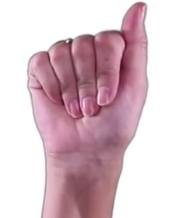
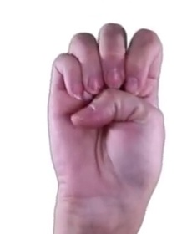
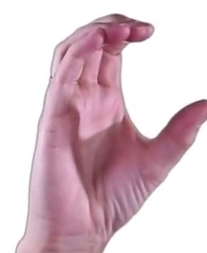
Pictures and predictions on video
We took the following images from the video for the prediction
A (0) C(2) E(4) G(6)

Slide 13
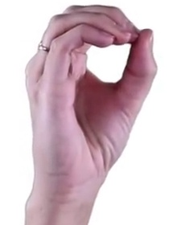
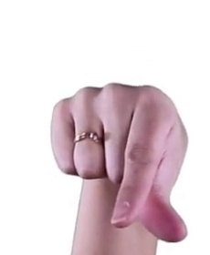
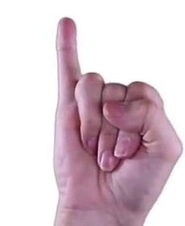
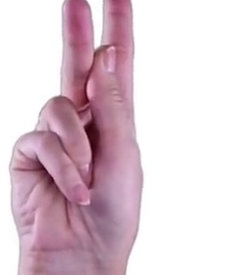
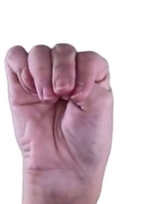
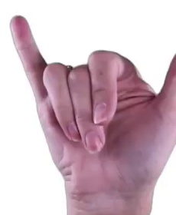
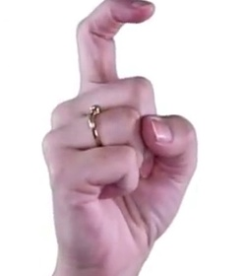
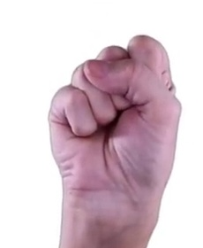
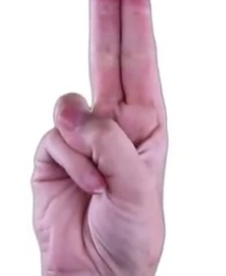
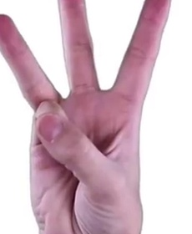
I(8) K(10) M(12) O(14) Q(16)
S(18) T(20) W(22) Y(24) X(23)

Slide 14
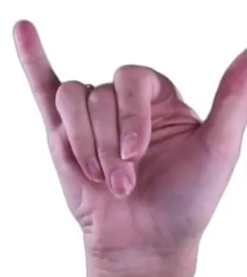
The real Images are in order of appearance:
0,2,4,6,8,10,12,14,16,18,20,22,24,23,24
Those are the results that we expect from our
models.
Y(24)

Slide 15
Predictions on the video images
Convolutional
Real : [ 0 2 4 6 8 10 12 14 16 18 20 22 24 23 24]
Predicted: [ 0 2 0 7 23 13 0 14 7 14 13 24 24 23 24]
6 out of 15
Artificial
Real : [ 0 2 4 6 8 10 12 14 16 18 20 22 24 23 24]
Predicted: [16 2 16 7 16 16 16 16 16 16 2 5 0 23 8]
3 out of 15

Slide 16
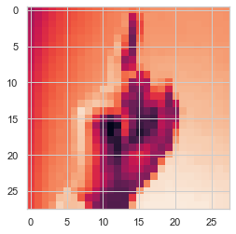
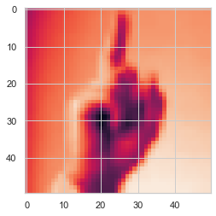
Image process
In order to properly train the model for the images taken by the video and the live predictions we had resize the dataset to 50x50.
Before After

Slide 17
On video predictions
To predict on video we have :
Created a mask that tracks movement on the video
Found the contours , meaning the boundaries of the object moving
Set the area of the contours to be over 2000 to avoid small movements
After the 600th frame of the video , we made a every frame gray scale,took the area inside the bounding boxes, resized it to 50x50 and gave it to our model to predict the letter shown.

Slide 18
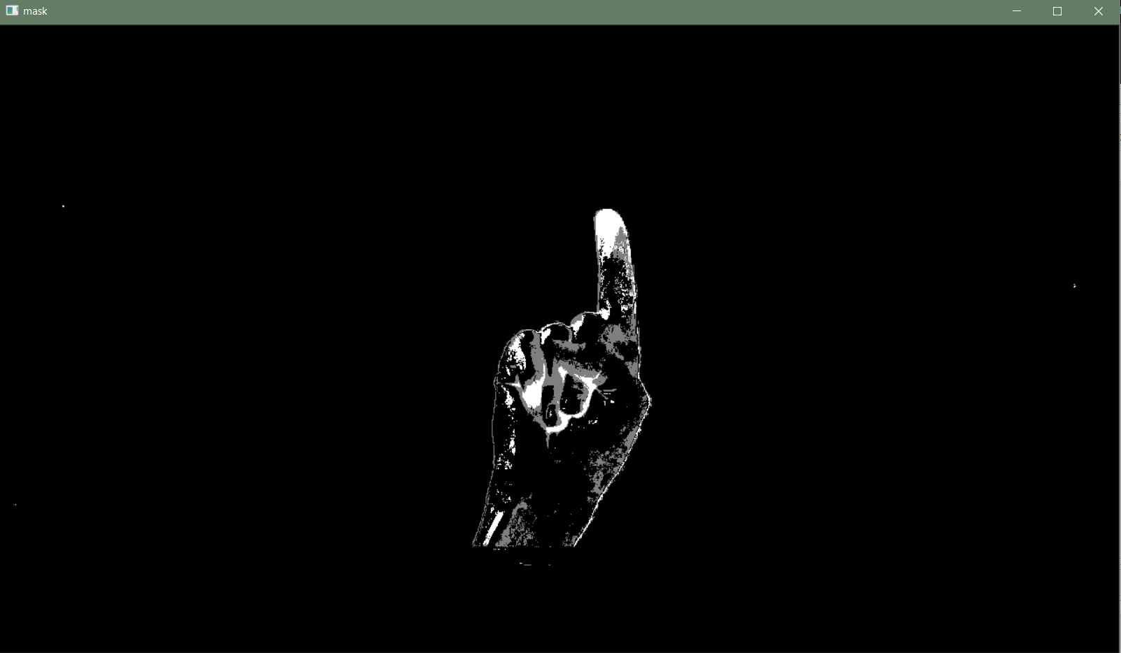
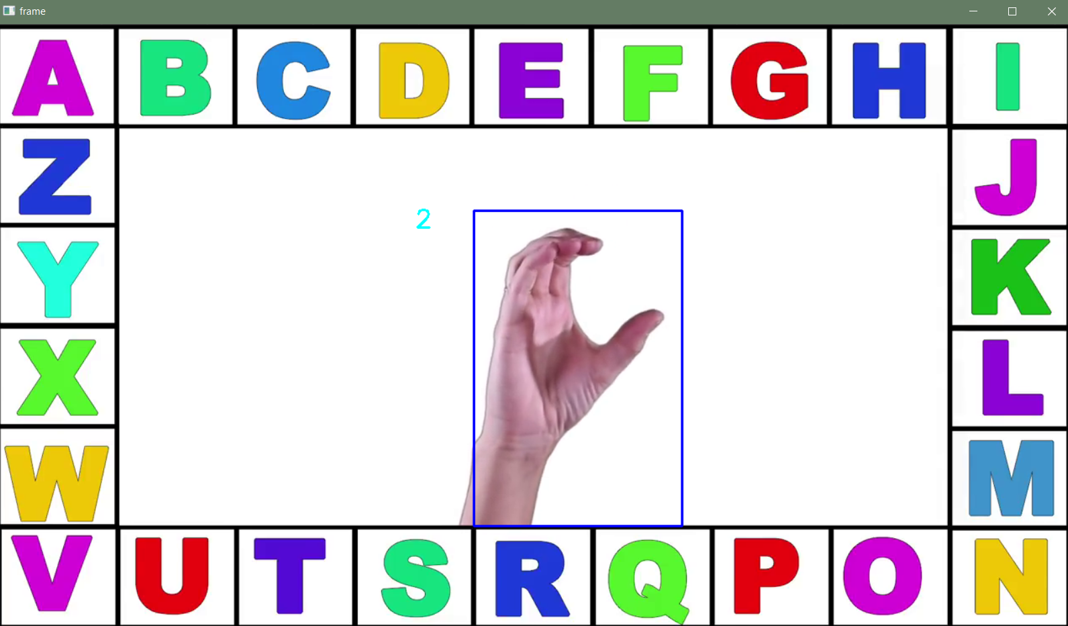
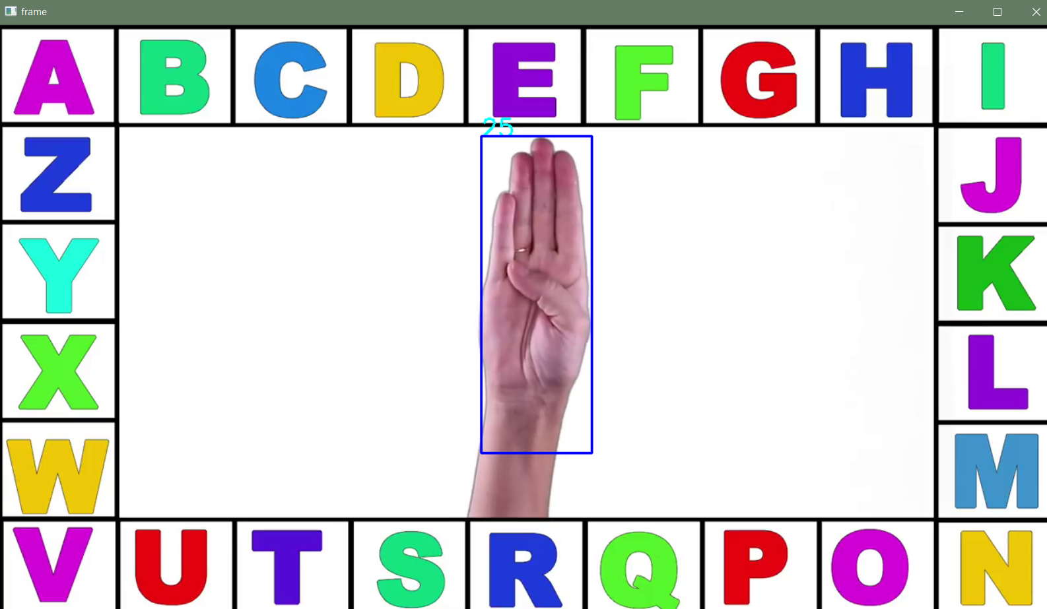
Mask Predictions on video

Slide 19

Video of live predictions

Slide 20
Conclusions
Convolutional model was better.
Image augmentation was necessary.
The random factor impacts greatly the predictions on the images.
The train images could be better.
Higher computational power is necessary for realistic applications.
An object detector would probably give better results.

Slide 21
Thank you for your time.

